Slide 1
Project Description and Client Review
Ali Saheb
Web: http://alisaheb.github.io/cv/
E-mail: alisaheb44@gmail.com

Slide 2
Question Answer
Yes, I try to do pray everyday.
Time : In the lunch break(12:45PM to 1:00PM).
Place : saintly and quite place for this 15 minutes.
Pork, alcohol etc. I have no problem if anyone drink in front of me. If I go for a party then I take another drinks like soft drinks.

Slide 3
Profile of marketplace
Fiverr: I have been working here last one year here I have done 2 project which was outstanding. Profile link: https://www.fiverr.com/a_saheb.
I have also experience to work in some other marketplace like upwork, freelancer etc.

Slide 4
My client feedback from fiverr
A fantastic experience. A diligent worker, fast delivery and excellent communications. Very impressed with how thorough he was and the quality of the deliverable. I will definitely be using him again and would recommend him.
excelent

Slide 5
My client feedback from Upwork
After some problems starting up he managed to do the job correctly. He is a professional in PSD to Joomla conversion. I will hire him again.

Slide 6
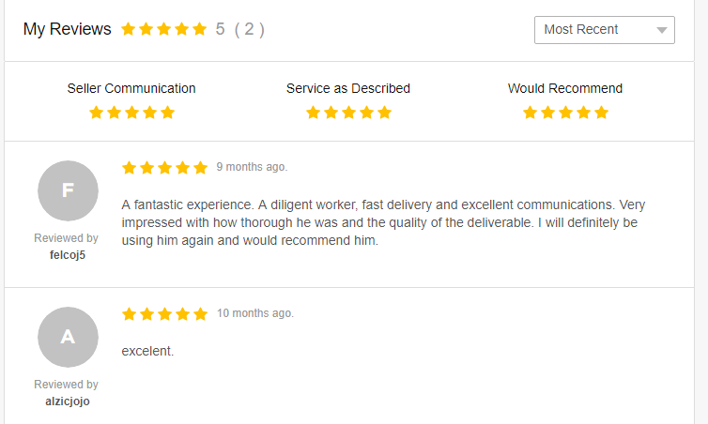
Image of client comment (Fiverr)

Slide 7
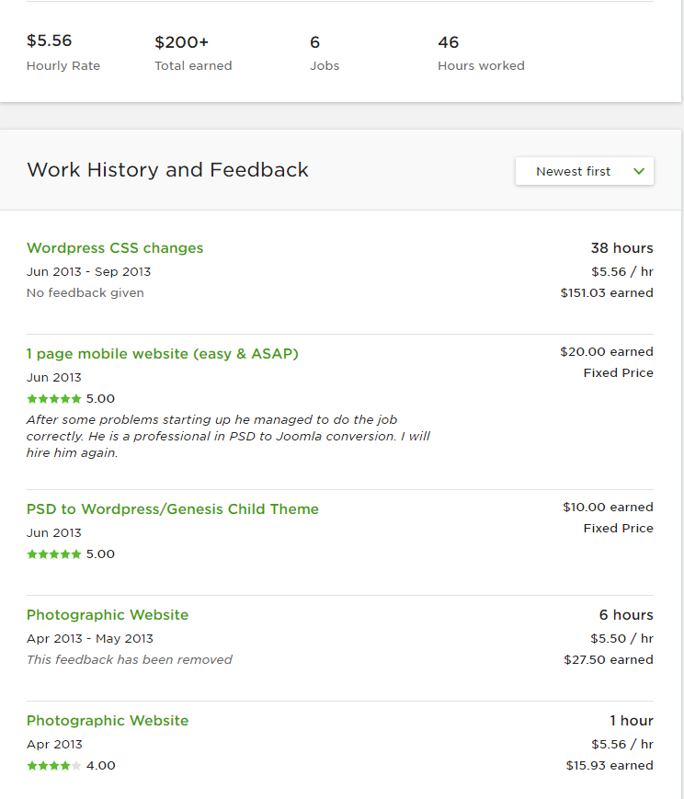
Image of client comment (upwork)

Slide 8
Project Description
Inventory Management System
Project Url: http://project.jakarea.me/modern/public/auth/login
User: admin Pass: welcome
Description: It is simple pos system. Here you can create product. This product you can sell. This product you can purchase from the provider. This application have a good stock management system. Application manage the customer you can deal with customer for his due,payment and mange the customer. Application can manage the product provide and their dues and payment. This application have good product searching system if the sales center have thousands of product it can easily handle it. Most challenging task of this project was creating the report application has a good reporting system it can produce stock report, customer ledger, Supplier ledger, Sales report. At the end application successfully run on different sales center and it can handle medium size company business.

Slide 9
Project Description (Continue…)
The Law App
Project url: https://thelawapp.com.au/
Project Source: https://github.com/alisaheb/thelawapp
User List:
Cient:
User: arif@seolytics.com.au Pass: Nexus2010
Lawyer:
User:mukul.ashad@gmail.com Pass:Nexus2010
Project Description : The Law App was created to give everyone access to the lawyers they want at a price they can afford. It’s not that we believe that lawyers always charge too much for their services it’s just that we can provide a way for lawyers to reduce their substantial costs and charge out rates by providing a cost effective place to advertise and a way to reduce their running costs so they can pass the savings on to clients. We also understand that the legal industry prides itself on an ethos of assisting those less financially able where there is a need for equity in legal representation. So we put the power in both the client’s and the lawyer’s hands. You can set a budget for what you want your lawyer to work to, or you can enter negotiations with lawyers to get the best deal for the problem. So whether you are looking for the best lawyer in the field or the best lawyer you can afford, The Law App Online is the complete legal marketplace to get great value from professionally accredited lawyers. Prospective clients can rest assured that we have done what’s necessary to make sure the lawyers who provide you with their services are qualified and legally able to represent you in your legal matter.

Slide 10
Project Description (Continue…)
PurMusic
Project Source: https://github.com/alisaheb/MUDI-MUSIC
Project Description: In this application our team try to applying a new musical business thinking and in this application my role is “web developer”. This application have three user role Band, Publisher and super user. Publisher can upload musical score as mxl file and this mxl file will zip with publisher key that’s means if any unauthorized person get this file he/she can not access this file and this file will be store in google drive. In the Band side the band can purchase the musical score and then they can access this file and this file will be access with a Android Device. For this Android application this web application produce api. The application produce the musical score api and login api. The super admin can mange the publisher and band and produce report.

Slide 11
Project Description (Continue…)
Password Breaker
Source code: https://github.com/alisaheb/passwordBraker
Project Description : This project was my simple try to apply distributed system concept. It can find the 5 character key within a minute.

